Slide 1
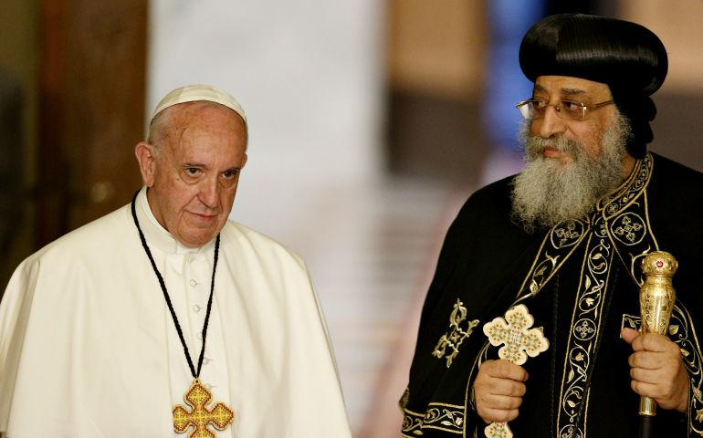
Orthodoxy - Catholicism

Slide 2
Orthodoxy - Catholicism
The Papacy
The Filioque
Purgatory and Indulgences
The ‘New Dogmas’
Immaculate conception of St. Mary
Papal Infallibility
The Assumption
5. Practice

Slide 3
Orthodoxy – Catholicism
1. Papacy
Pope Heraclas (Pope of Alexandria 232-248)
Pope Marcellinus (Pope of Rome 296-304)

Slide 4
Orthodoxy – Catholicism
Papacy
“First among equals”
Universal (catholic)
“Universal Papal Jurisdiction”
“Vicar of Christ”
Catholic
Notes:
¹⁶ Simon Peter replied, “You are the Christ, the Son of the living God.”^{[a]} ¹⁷ And Jesus answered him, “Blessed are you, Simon Bar-Jona! For flesh and blood has not revealed this to you, but my Father who is in heaven. ¹⁸ And I tell you, you are Peter,^{[b]} and on this rock^{[c]} I will build my church, and the powers of death^{[d]} shall not prevail against it.^{[e]} ¹⁹ I will give you the keys of the kingdom of heaven,^{[f]} and whatever you bind on earth shall be bound in heaven, and whatever you loose on earth shall be loosed in heaven.”
The Orthodox church considers the Bishop of Rome to be the primus inter pares.^{[111][discuss]} Many^{[example needed]} theologians also believe that Peter is the rock referred to by Jesus in Matthew 16:18.^{[112]}
However, in Matthew 16:18 the keys were given not only to Peter but to all the Apostles equally. Such an interpretation, it is claimed,^{[113]} has been accepted by many Church Fathers; Tertullian,^{[h]} Hilary of Poitiers,^{[i]} John Chrysostom,^{[j]} Augustine.[117][k][119][120][l][disputed – discuss]
It has been argued that Church councils did not consider papal decisions binding. The Third Ecumenical Council was called, even though Pope Celestine I condemned Nestorius as a heretic which Michael Whelton, Catholic convert to Orthodoxy, argues shows that the council did not consider the papal condemnation as definitive.^{[122][123]}
The Orthodox understand the term Catholicity or Universal as being part of the one universal church by adherance to Scripture and tradition not by adherring to a particular see.

Slide 5
Orthodoxy – Catholicism
2. The “Filioque”
“…And the Son...”
Council of Nicea 325 AD
Council of Constantinople 381 AD
“But when the Help comes, whom I shall send to you form the Father, the Spirit of truth who proceeds from the Father, He will testify of Me.” John 15:26

Slide 6
Orthodoxy – Catholicism
The “Filioque”
Council of Toledo 589AD
Charlemagne tried to force the Roman Church to add this clause ~ 800AD
German King HenryII – Pope Benedict VIII sung the Filioque for the first time in Rome 1014AD
Notes:
This idea was influenced by the western teachings of Terullian and Augustine
Charlemagne tried to force pope Hadrian I to include this cluase by he refuesed
Which cuased the Great schism between east and west in 1054AD

Slide 7
Orthodoxy – Catholicism
3. Purgatory & Indulgences
An intermediate state after death for the purification of sin – temporal punishment
Temporal punishment –expiated by Indulgences.
Indulgence = gifts of merits of Christ & saints
Indulgence is a way to reduce the amount of punishment
Notes:
What is Purgatory:
Purgatory is the state of those who die in God's friendship, assured of their eternal salvation, but who still have need of purification to enter into the happiness of heaven.
Catholics use this verse to support their belief in Purgatory:
2 Mac 12:44-46 - for if he were not expecting the fallen to rise again, it would have been useless and foolish to pray for them in death. But if he did this with a view to the splendid reward that awaits those who had gone to rest in godliness, it was a holy and pious thought. Thus he made atonement for the dead that they might be freed from this sin.
They also quote the words of Jesus Christ, "Anyone who speaks a word against the Son of Man, it will be forgiven him; but whoever speaks against the Holy Spirit, it will not be forgiven him, either in this age or in the age to come. (Matt 12:32)
The quote from the book of Maccabees and our Savior’s words can only prove that some sins will be forgiven after death; but whether by means of punishment by fire, or by other means, nothing is known for certain.
What has forgiveness of sins to do with punishment by fire and tortures?
Only one of these two things can happen: either punishment or forgiveness, but not both at once.
In his book entitled ‘Why Do We Reject Purgatory?’, Pope Shenouda III refers to 1 Thess 4:16,17, "And the dead in Christ will rise first. Then we who are alive and remain will be caught up together with them in the clouds to meet the Lord in the air. And thus we shall always be with the Lord", in which St. Paul describes the Last Day saying that those faithful who are still alive will meet the Lord with those who rise from the dead and then remain with Him always.
He then asks the question, "Are these faithful (alive on the Last Day) exempt from Purgatory? Or is God showing partiality towards them?"

Slide 8
Orthodoxy – Catholicism
Purgatory & Indulgences
2nd Council of Lyon 1274 AD
1. some souls are purified after death;
2. such souls benefit from the prayers and pious duties that the living do for them.
Notes:
At the Second Council of Lyon in 1274, the Catholic Church defined, for the first time, its teaching on purgatory, in two points:
some souls are purified after death;
such souls benefit from the prayers and pious duties that the living do for them.
So how do you get the indulgence, by performing certain good deeds, eg. Pilgrimage, certain prayers etc.
e.g. Pope francis offered indulgences to those who took part in world meeting of family events in Dublin
e.G Pope frances offered indulgences for those who watched the twitter for world youth day
Pope benedict offered indulgences in 2012-2013 for those who participated in Year of Faith can receive a special indulgence, the Vatican said.
By the middle ages you can imagine that indulgences became abused and bishops and the priests were charging people for indulgences this is actually what sparked the martin luther and the protestant movement
So where did the idea of purgatory and indulgences come from?
From the Orthodox understanding of praying for the departed…

Slide 9
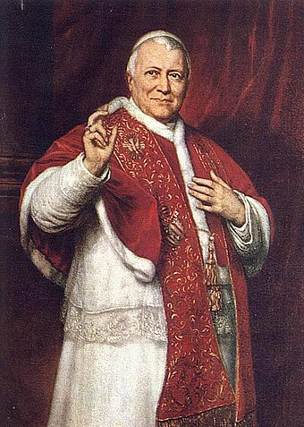
Orthodoxy – Catholicism
New Dogma
Immaculate conception.
St. Mary was by a single grace and privilege conceived without the stain of original sin.
Pope Pius IX – 1854 – Ineffabilis Deus (ineffable God)
Romans 5:12
Pope Pius IX (1846–1878), during whose papacy the doctrine of papal infallibility was dogmatically defined by the First Vatican Council
Notes:
The problem with this doctrine is two things
Why St Mary can be born this with out sin.
The understanding of Original sin. The Catholis see origninal sin as the stain of inherited guilt
While in Orthodoxy we understand sin as a curse, which is the curse of death and all humans are under the curse of sin ie.e death mortal. And so by saying that St. Mary is without sins means she is not mortal.
Infact we say the opposite that she is the first human to receive the great blessing of salvation.

Slide 10
Orthodoxy – Catholicism
New Dogma
2. Papal infallibility
1st council of the Vatican 1869- 1870
3. Assumption of St. Mary.
1950 – by Ex Cathedra decree, Pius XII
Notes:
According to Catholic theology, there are several concepts important to the understanding of infallible, divine revelation: Sacred Scripture, Sacred Tradition, and the Sacred Magisterium (Teaching Authority). The infallible teachings of the Pope are part of the Sacred Magisterium, which also consists of ecumenical councils and the "ordinary and universal magisterium". In Catholic theology, papal infallibility is one of the channels of the infallibility of the Church. The infallible teachings of the Pope must be based on, or at least not contradict, Sacred Tradition and Sacred Scripture.
The doctrine of infallibility relies on one of the cornerstones of Catholic dogma: that of Petrine supremacy of the pope, and his authority as the ruling agent who decides what are accepted as formal beliefs in the Roman Catholic Church.^{[4]} The use of this power is referred to as speaking ex cathedra.^{[5]} The solemn declaration of papal infallibility by Vatican I took place on 18 July 1870. Since that time, the only example of an ex cathedra decree took place in 1950, when Pope Pius XII defined the Assumption of Mary as an article of faith.^{[6]} Prior to the solemn definition of 1870, there were other decrees which fit the definition of ex cathedra, for example, Pope Boniface VIII in the bull Unam Sanctam of 1302,^{[7][8][9]} and Pope Pius IX in the Papal constitution Ineffabilis Deus of 1854
Assumption of St. Mary is Church Tradition not a dogma

Slide 11
Orthodoxy – Catholicism
Different Practice
Baptism full immersion Vs sprinkling
Baptism and confirmation together Vs separate
Communion body & blood vs body only
Priests are married vs Celibate

