Slide 1
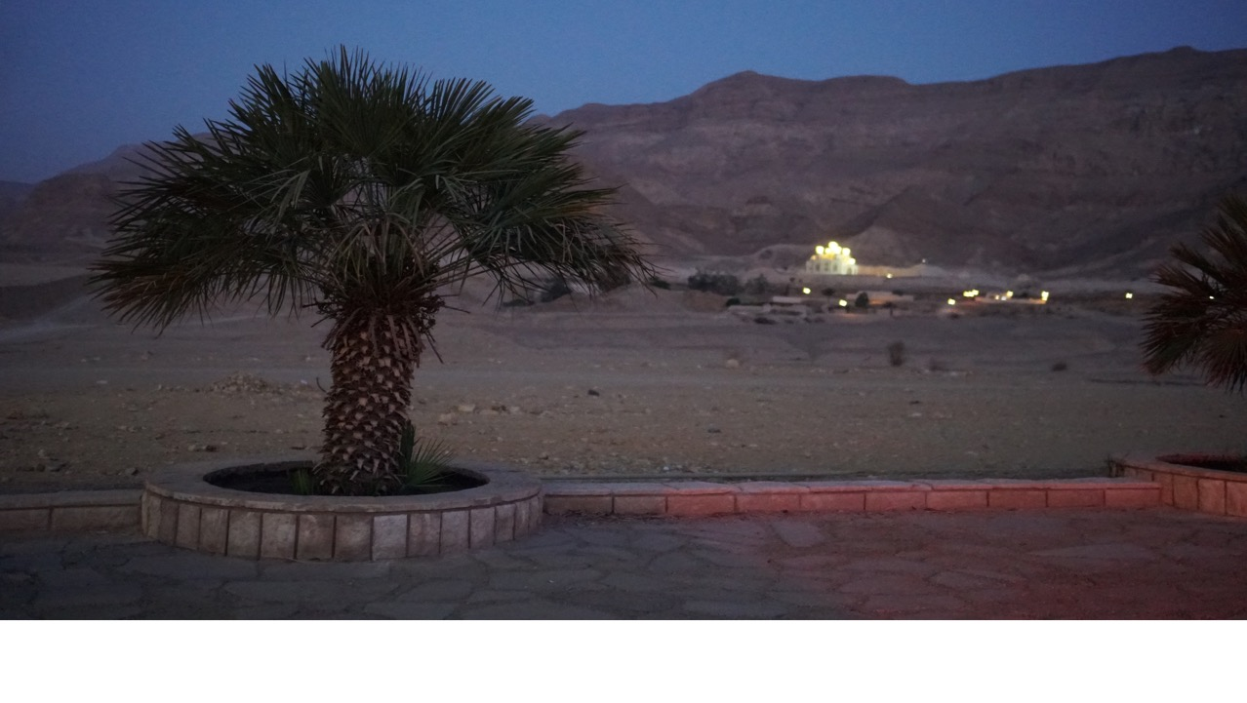
The Great Fast

Slide 2
INTRODUCTION

Slide 3
New Year – Nativity fast
New Year – Nativity fast
New Year – Nativity fast
In the Church . . .
WHAT do we do?
WHY do we do it?
HOW do we do it?
Notes:
Why are we learning about the seasons out of the Church? It’s because we are learning about our Church. The

Slide 4
Coptic Year
New Year – Beginning of Nativity fast
Nativity – Great Fast & Holy Week
Pentecost – Apostle’s Fast until the New Year
Holy
Spirit
Father
Son

Slide 5
Great Lent & Holy Week

Slide 6
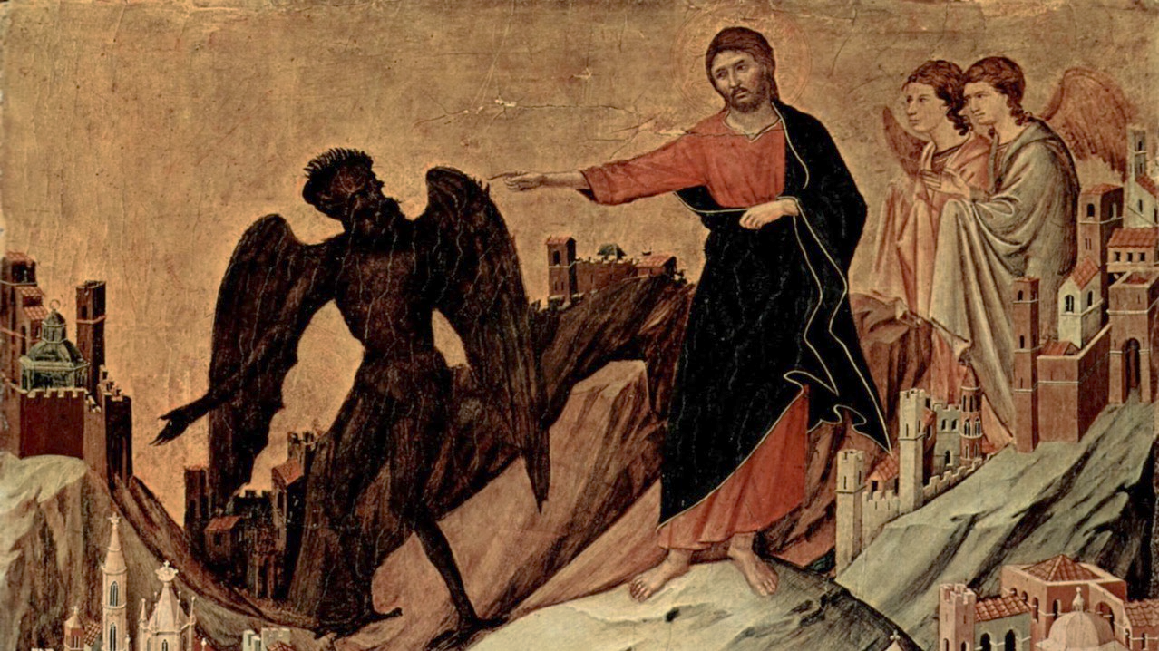
What is Great Lent?
A historical perspective
Past & Present

Slide 7
What is Great Lent?
At Present

Slide 8
At Present
A period of fasting before commemorating the last week of Christ’s life,
His death, and His resurrection

Slide 9
At Present
7
40
How long?

Slide 10
At Present
7
M | T | W | TH | F | Sat | Sun
“Preparation Week”
1
2
3
4
5
6
7 days
7
40
7 days
14
7 days
21
7 days
28
7 days
35
40 days
Christ Fasted
5 days = 40
Lazarus
Saturday
Palm Sunday

Slide 11
St. Ignatius
At Present
“Despise not the period of forty days, for it comprises an imitation of the conduct of the Lord. After the week of the passion, do not neglect to fast on the fourth and sixth days, distributing at the same time of thine abundance to the poor. If any one fasts on the Lord’s Day or on the Sabbath, except on the paschal Sabbath only, he is a murderer of Christ.”
Alternative View
40
7
5
8
M | T | W | TH | F | Sat | Sun
1
2
3
4
5
6
7
8
5 weekdays
5
5 weekdays
10
5 weekdays
15
5 weekdays
20
5 weekdays
25
5 weekdays
30
5 weekdays
35
5 weekdays = 40
Holy Week

Slide 12
Pope Shenouda
At Present
Alternative View
“The sacred forty days which Christ
fasted, is preceded by a week considered either as an
introductory week for the sacred forty days or as compensation
for the Saturdays when abstention from food is not allowed.”
40
7
5
8
M | T | W | TH | F | Sat | Sun
1
2
3
4
5
6
7
8
5 weekdays
5
5 weekdays
10
5 weekdays
15
5 weekdays
20
5 weekdays
25
5 weekdays
30
5 weekdays
35
5 weekdays = 40
Holy Week

Slide 13
Rites
At Present
1245 AD collection of Church and Civil Laws by “Al-Safawy Le Ibn Al-Assal”:
Abstain until sunset & no fish
“All Nazarene (‘Nassara’ meaning Christians) are required to fast the holy forty days (lent) …. This fast is to be abstention to the end of the day (sunset around 6 PM). … No abstention on Sundays or Saturdays.”
No Synaxarion feasts during week
“During the forty days (lent) they should not celebrate the martyrs on week days, but to do those remembrance only on Saturdays and Sundays.”
No social celebrations
“During the forty days (lent) there should be no wedding, no celebration, and no sitting to drink (parties or social gatherings).
Very Sorrowful Tunes
Prostrations
Fasting =
1) ABSTAINING for a period of time and feeling hungry (set by Church but can be tailored by Father Confessor)
2) Then, LIMITING what you eat
Kind
Quantity
Quality
M | T | W | TH | F | Sat | Sun
1
2
3
4
5
6
7
8
Strict Abstinence From Food
Fasting until a late 6pm*
No
Abstinence
Allowed
Holy Week

Slide 14
At Present
Themes and Readings
Daily readings have themes and not tied to Synaxarion – Special Lent Lectionary
Old Testament Readings
No Synaxarion
M | T | W | TH | F | Sat | Sun
Sunday Readings
1 | Treasures in Heaven | Setting the stage
2 | Temptation Sunday | Christ’s example
3 | Prodigal Son | Return to Christ
4 | Samaritan Woman | Christ seeks you and preach
5 | Healing the paralytic | Faith
6 | Healing man born blind | God’s power to create and renew
7 | Palm Sunday | Triumphant

Slide 15
What is Great Lent?
The Past

Slide 16
The Past
“It is a customary practice for the bishops to issue mandates for fasts to the universal commonalty of the Church”
- Tertullian (c. AD 225)
Unclear. “forty day” fasts around, but not clear if immediately before Holy Week. Various jurisdictions did things differently
Pope Demetrius
12th Pope of Coptic Church
Theophany & Great Lent
Council of Nicea
More formal “40” day fast implemented before Holy Week
c. 250
100 AD
325 AD

Slide 17
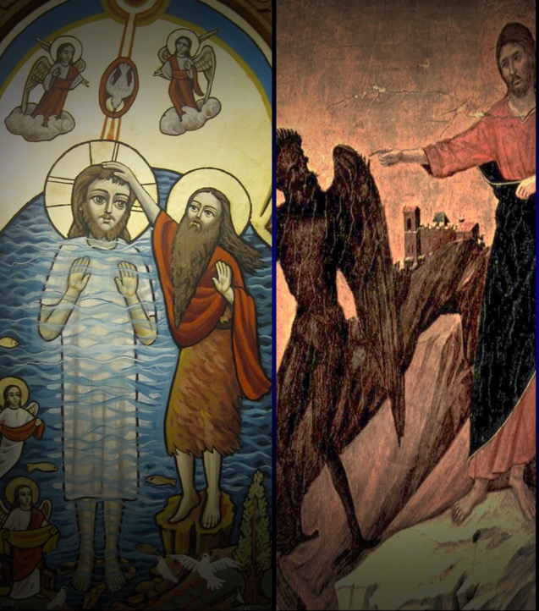
3 year
ministry
Theophany
(Baptism)
40 Days Fasting
Ministry
begins
Day 1
40 days

Slide 18
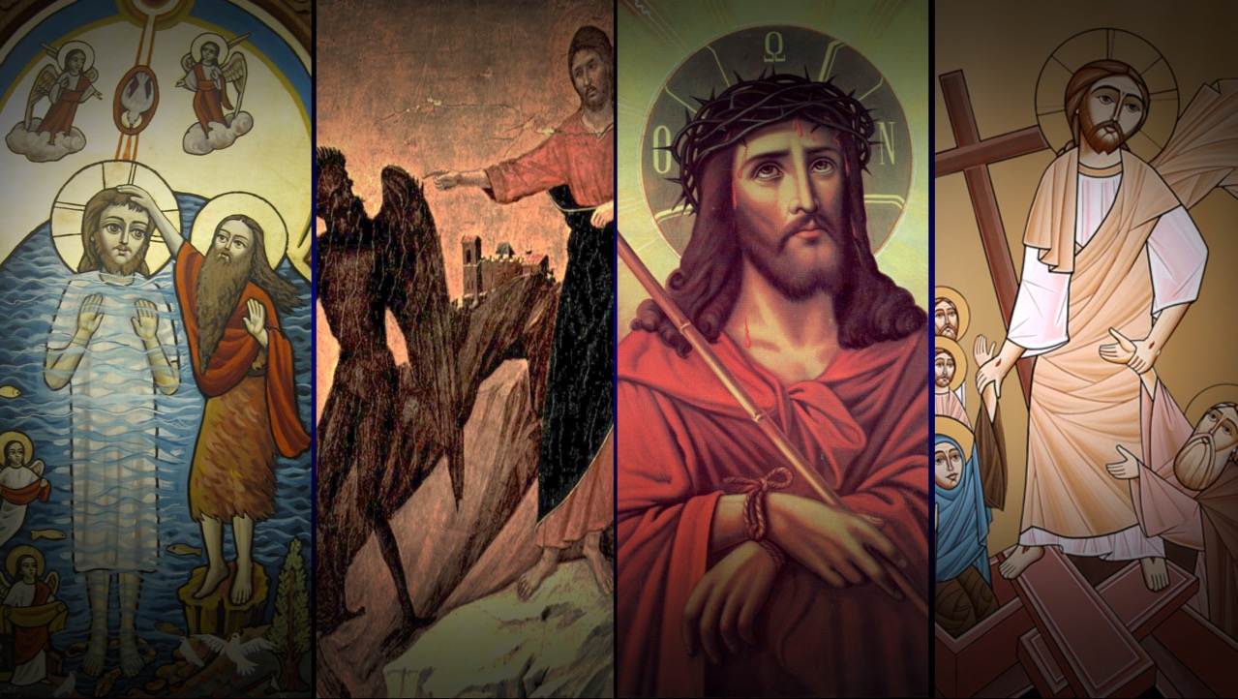
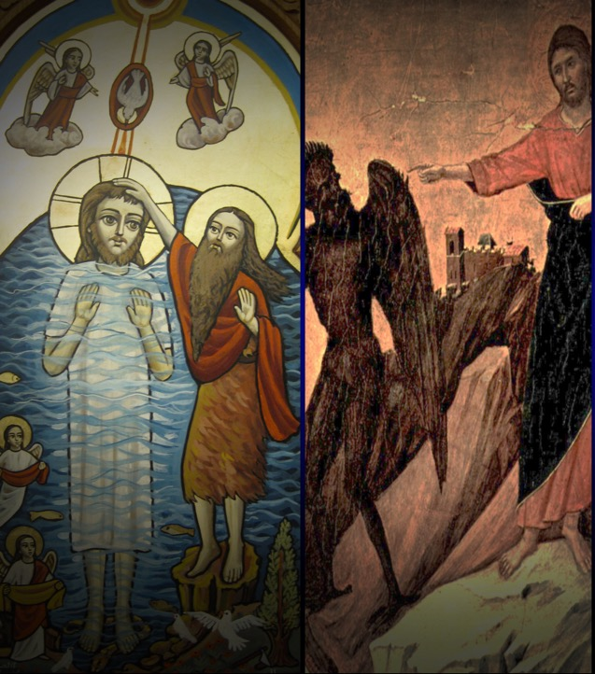
Theophany
(Baptism)
40 Days Fasting
Last Week
(Holy Week)
Resurrection
Day 1
40 days
3 year
ministry
Ministry
begins
M-F
Sunday

Slide 19
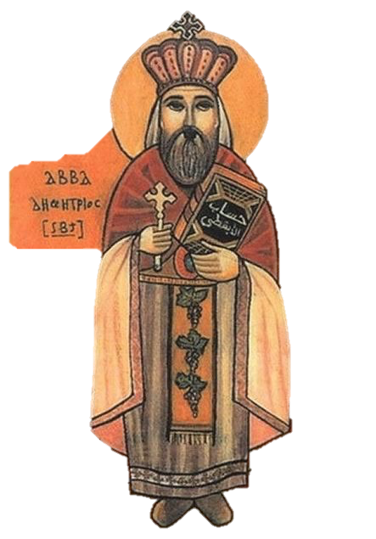
”He appended the Holy Fast to the Passion Week. Pope Demetrius wrote in this respect to the Patriarchs of Jerusalem, of Antioch, of Rome, and to others. They all approved and followed it.”
— Coptic Synaxarion Reading commemorating Pope Demetrius,
12th Coptic Pope

Slide 20
The Past
Alexandrian (Coptic) Pope tasked with informing other jurisdictions of feast date
Regular practice to teach Catechumens during Lent, to prepare them for Baptism before Resurrection
St. Athanasius becomes Coptic Pope, writes yearly letters
325 AD
328 AD

Slide 21
The Past
St. Athanasius becomes Coptic Pope, writes yearly letters
Hercules Week added
Now known as “preparation week”
328 AD
616 AD

Slide 22
The Past
[After Al-Safawy discusses the ”40 day” Lent Fast]
“There are other fasts in the Coptic Church … Hercules Week ….”
— 1245 AD collection of Church and Civil Laws
by “Al-Safawy Le Ibn Al-Assal”
Hercules Week added
Now known as “preparation week”
616 AD

Slide 23
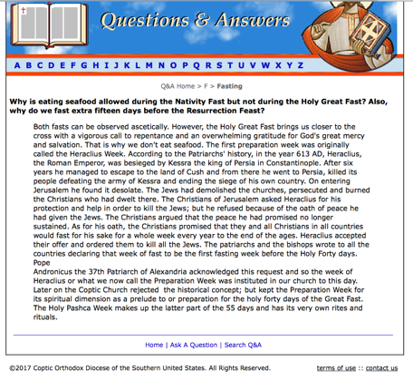
The Past
Hercules Week added
Now known as “preparation week”
616 AD
Notes:
http://www.suscopts.org/q%26a/index.php?qid=1268&catid=147

Slide 24
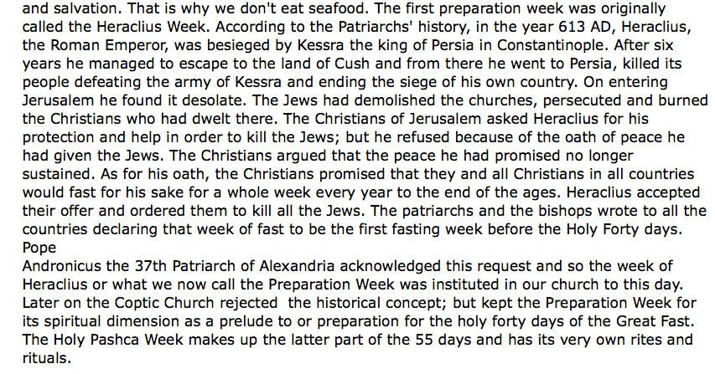
The Past
Hercules Week added
Now known as “preparation week”
616 AD
Notes:
http://www.suscopts.org/q%26a/index.php?qid=1268&catid=147

Slide 25
The Past
Hercules Week added
Now known as “preparation week”
Lent period as currently practiced in Coptic Church fixed
616 AD
Today

Slide 26
What is Great Lent?
Spiritual Reflection

Slide 27
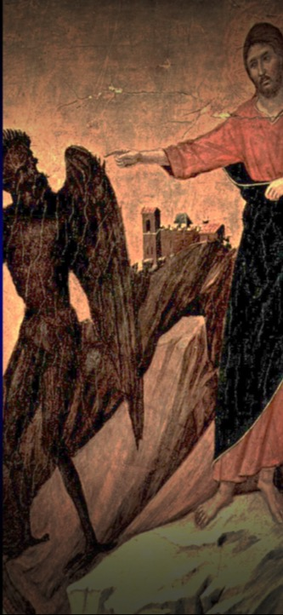
St. John’s First Epistle
Spiritual Reflection
“Then Jesus came from Galilee to John at the Jordan to be baptized by him…. (Mt 4:13)
“Then Jesus was led up by the Spirit into the wilderness to be tempted by the devil. 2 And when He had fasted forty days and forty nights, afterward He was hungry…. (Mt 4:1-2)
“From that time Jesus began to preach… (Mt 4:17)
Christ set an example
Do we fast and pray before we embark on our services for God?
Do we invite God in with fasting before important events and decisions?

Slide 28
St. John
Spiritual Reflection
“ought also to walk just as He walked”
—(1 John 2:6)
“For I have given you an example, that you should do as I have done to you.
—(John 13:15)
“Do not love the world or the things in the world. If anyone loves the world, the love of the Father is not in him. For all that is in the world—the lust of the flesh, the lust of the eyes, and the pride of life—is not of the Father but is of the world.” (1 Jn 2:15-16)
Do not love the world
Satan's temptations focused on three crucial areas, which are in need of addressing, not Christ:
a) physical desires (lust of the flesh)
b) possessions and power (lust of the eyes) c) pride (pride of life)
H.H. Pope Shenouda III
If Jesus Christ observed this fast for us, though He did not
need to, we should therefore fast it for ourselves since we are in
great need of fasting to fulfil all righteousness, in the same way
as Christ did.

Slide 29
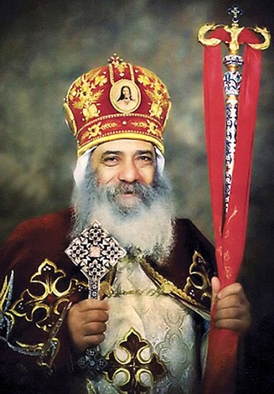
Pope Shenouda
Spiritual Reflection
Keep the Fast, Enjoy it, and Benefit from It
It is a period of spiritual reserve up for the whole year.
He who does not benefit spiritually from it, will hardly benefit
from the other less spiritual days. He who spends the days of
Lent indifferently will find it hard to be particular about the rest
of the year.
Try to benefit from this fast, its hymns, readings, rites,
spirituality and the afternoon liturgies

Slide 30
Pope Shenouda
Spiritual Reflection
Keep the Fast, Enjoy it, and Benefit from It
It is "Great" because of its duration and sanctity.
It is the longest of all fasts as it extents for fifty-five days, and it
is the greatest in its sanctity as it is Christ’s fast and
commemorates His sacred suffering.
At this point, I address all in reproach:
How many Lents have passed by us with all the spirituality’s of
the "Great Fast"? If we have gained some spiritual benefit from
every fast, what is our harvest from these "Great Fasts" and
from the other fasts that we kept?
The point is that, in fasting, we are in need of seriousness and
spirituality and should not pursue the matter in a routine and
careless manner.

Slide 31
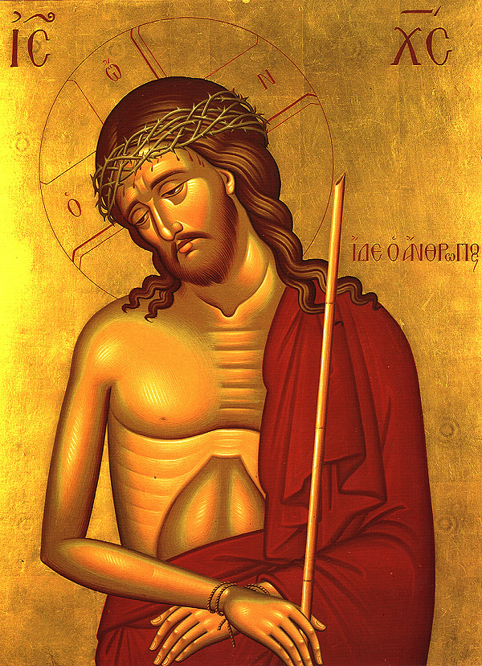
History of
HOLY WEEK

Slide 32
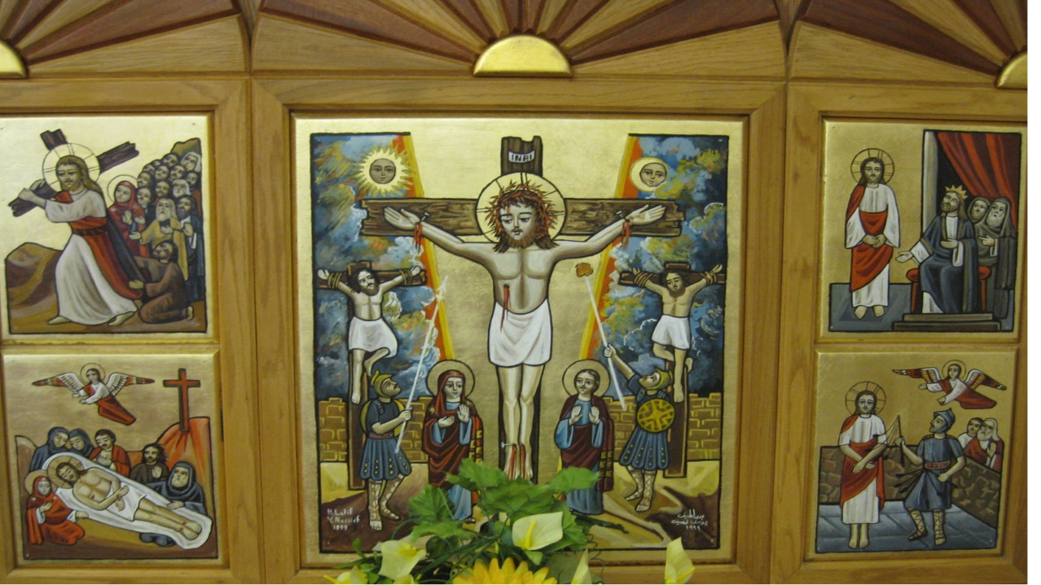
Holy Week
A historical perspective
Past & Present

Slide 33
Holy Week
At Present

Slide 34
At Present
A period of fasting just before the Resurrection Feast, during the last week of Christ’s life

Slide 35
At Present
6
How long?
days

Slide 36
At Present
6
days
Lazarus
Saturday
Palm Sunday
Bright
Saturday
Last week of Lent
Holy Week
M | T | W | TH | F | Sat | Sun
M | T | W | TH | F | Sat | Sun
Resurrection
Last day of Lent
Clear demarcation
Of end of Lent
By Coptic and Eastern Orthodox

Slide 37
At Present
Holy Week (aka “Pascha” or Passover Week)
M | T | W | TH | F | Sat
“Christ the Bridegroom” Theme - Be prepared to receive Him
Shared theme with Eastern Orthodox and some shared readings
Shared prayer with Eastern Orthodox, which they chant while on Monday Eve (Palm Sunday Night), place “Bridegroom icon”:
Behold, the Bridegroom is coming at midnight, blessed is the servant whom He finds watching. But he whom He finds sleeping is unworthy of going with Him. Therefore, take heed, O my soul, that you may not fall into deep sleep, and then be cast out of the Kingdom. But watch and cry out saying “Holy, Holy, Holy are You, O God; for the sake of the Theotokos, have mercy on us.”

Slide 38
At Present
Holy Week (aka “Pascha” or Passover Week)
M | T | W | TH | F | Sat
Day | Day | Day | Day | Day | Vigil
Eve | Eve | Eve | Eve
Each Day, and each Eve service has 5 segments “hours” of prayers
1st, 3rd, 6th, 9th, 11th
1
3
6
9
11

Slide 39
At Present
Holy Week (aka “Pascha” or Passover Week)
M | T | W | TH | F | Sat
Day | Day | Day | Day | Day | Vigil
Eve | Eve | Eve | Eve
Prophecies
Pascha Praise
Psalm chanted in long, sad tune
Gospel
Litanies
Exposition
Occasional Commentary by Church Father
1
9
PATTERN EACH HOUR
3
11
6

Slide 40
At Present
Holy Week (aka “Pascha” or Passover Week)
M | T | W | TH | F | Sat
Day | Day | Day |  |  | Vigil
Eve | Eve |  | Eve
Christ Betrayed by Judas
Covenant
Thursday - Mystical Supper
Good “Great”
Friday
Christ Crucified
Bright Saturday

Slide 41
At Present
Holy Week (aka “Pascha” or Passover Week)
M | T | W | TH | F | Sat
We commemorate this week nearly EVERY week of the year
Wed & Friday
Thurs & Sun

Slide 42
Holy Week
The Past

Slide 43
The Past
“But He commanded us to fast on the fourth and sixth days of the week; the former on account of His being betrayed, and the latter on account of His passion.”
– Didascalia
Different places commemorated it differently.
Some a few days
Some the entire week.
Eventually by Council of Nicea, all jurisdictions commemorated the entire week.
“After the week of the passion, do not neglect to fast on the fourth and sixth days”
– St. Ignatius
Early
Church
c. 100
c. 230

Slide 44
The Past
Pope Gabriel, 70th Pope, with the help of monks from the St. Macarius monastery:
Shortened the Pascha services
Organized and arranged rubrics of the readings
Shortened the total amount of readings
Selected suitable Old and New testament readings
Divided the service in 5 morning and evening hours
St. Athanasius writes Festal Letter describing Pascha fast as being 6 days long.
c. 330
c. 1140
Notes:
As writtten in Paope 5th, for Abba Peter of El-Bahnassa

Slide 45
The Past
Abba Peter, Bishop of El-Bahnassa further reformed the Pascha Week services:
Gathered better readings
Tried to make the reading lengths in each hour similar
Published it in a Pascha Lectionary
Added sermons, many of which from Abba Shenouda the Archimandrite, whose monastery this bishop was from.
Pope Gabriel Reforms
c. 1140
c. 1200
Notes:
As writtten in Paope 5th, for Abba Peter of El-Bahnassa

Slide 46
The Past
Arranged for 4 gospels to be read in entirety. Matthew Tuesday, Mark Wednesday, Luke Thursday, John Saturday
Established reading of all psalms after Good Friday
Composed tunes for many of the prayers. “Adribic” tune came from the monks of mount Adribah, where Abba Shenouda monastery. “El Lahn el Shamy” (Pekethronos for example) came from Mount Shamah, west of Luxor, where the monastery of martyr St. Tawardos was located.
Pope Gabriel Reforms
c. 1140
c. 1200
Notes:
As writtten in Paope 5th, for Abba Peter of El-Bahnassa

Slide 47
The Past
“All Nazarene [“Nassara” meaning Christians] are required … to fast on Wednesdays and Fridays of every week except in the Pentecost season.”
“One who does not fast the holy forty [the Great Fast], or Friday, or Wednesday, he should be cut off unless he has a physical reason like sickness.”
– Al-Safawy Ibn Al-Assal
Reforms by Abba Peter, Bishop of El-Bahnasa
c. 1200
1245
Notes:
As writtten in Paope 5th, for Abba Peter of El-Bahnassa

Slide 48
The Past
– Al-Safawy Ibn Al-Assal
“During these 6 days [Pascha Week], you eat only bread and salt with water. No meat or wine be consumed in
these six days, because they are days of sorrow. But for Friday and Saturday, those who can, fast them together as one day. But if you can not fast the two days, be sure to fast the Saturday because the bridegroom is taken.
Reforms by Abba Peter, Bishop of El-Bahnasa
c. 1200
1245

Slide 49
The Past
– Al-Safawy Ibn Al-Assal
“A priest who does not fast the lent and Wednesday and Friday should be excommunicated.”
Reforms by Abba Peter, Bishop of El-Bahnasa
c. 1200
1245

Slide 50
The Past
– Al-Safawy Ibn Al-Assal
“These two days [Wednesday and Friday] are to be fasted until the ninth hour (3 PM).”
Reforms by Abba Peter, Bishop of El-Bahnasa
c. 1200
1245

Slide 51
Holy Week
Spiritual Reflection

Slide 52
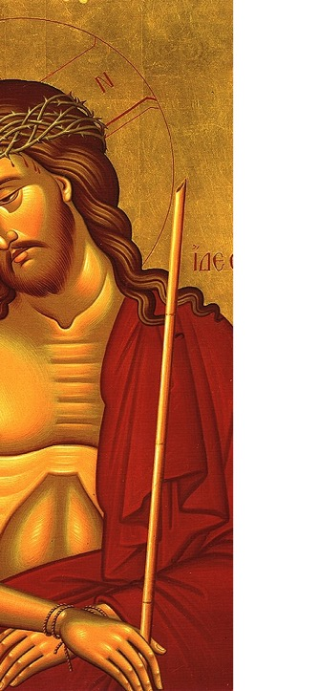
“Always carrying about in the body the dying of the Lord Jesus, that the life of Jesus also may be manifested in our body” (2 Corinthians 4:10).
“Those who are Christ’s have crucified the flesh with its passions and desires” (Galatians 4:24).
“Then He said to them all, “If anyone desires to come after Me, let him deny himself, and take up his cross daily, and follow Me” (Luke 9:23).
Spiritual Reflection
Do we die daily?
Or do we crucify Christ daily?
Do we just wear a cross, poorly representing Christ?
Or do we bear our cross?

